Slide 1
Profiling statistical language performance
Cecile Murray, Krista Chan, Katie Genadek, Virginia Gwengi, and Christian Moscardi
U.S. Census Bureau
Government Advances in Statistical Programming (GASP)
November 6, 2020
Disclaimer: This presentation is released to inform interested parties of ongoing research and to encourage discussion of work in progress. The views expressed are those of the author(s) and not necessarily those of the U.S. Census Bureau.

Slide 2
Roadmap
Background and research question
Data and methods
Results and initial conclusions
Areas for future work

Slide 3
Common research tasks run slowly
Researchers using Census Bureau data work with large-scale survey microdata on a custom HPC
Example: the universe of decennial census responses from 1990 = 249 million observations
Most work in SAS, but regardless of the language, researchers often perform similar data preparation tasks
We noticed that some of these common tasks take a long time to run, and such delays are costly to the agency

Slide 4




Which programming language offers the best performance?

Slide 5
Data
1990 full-count restricted decennial census
Three files per state: person, household, and geography
Responses from Delaware (DE), Nevada (NV), and Kansas (KS)
DE: 666K observations (small)
NV: 1.2M observations (medium)
KS: 2.5M observations (large)

Slide 6
Methods
Define a common set of operations
Write scripts in each language to execute those operations
Run scripts using the same resources
Measure performance using runtime and % CPU

Slide 7
Defining the common operations
For each state:​
Load data:​
Convert from native SAS format and load into memory
2. Merge person, household, geography files ​
Result: data frame where each row is a person linked to household and geographic info​
3. Three simple analytical tasks:​
Count number of people in each household​
Compute mean number of people per household by state​
Compute mean age by county

Slide 8
What would a reasonable user do?
One implementation per language
Goal: capture what a competent user of each language would write on a first pass
Approach tasks in the way that seems natural for each language
For loops in Stata and Python vs. map() in R
SAS and Stata macros vs. R and Python functions

Slide 9
Converting from SAS format
SAS users may have an advantage because Census already stores the microdata files in .sas7bdat
Stata: loop over all files to convert them to .dta, then read the .dta files
R: use haven::read_sas()
Python: use pandas pd.read_sas()

Slide 10
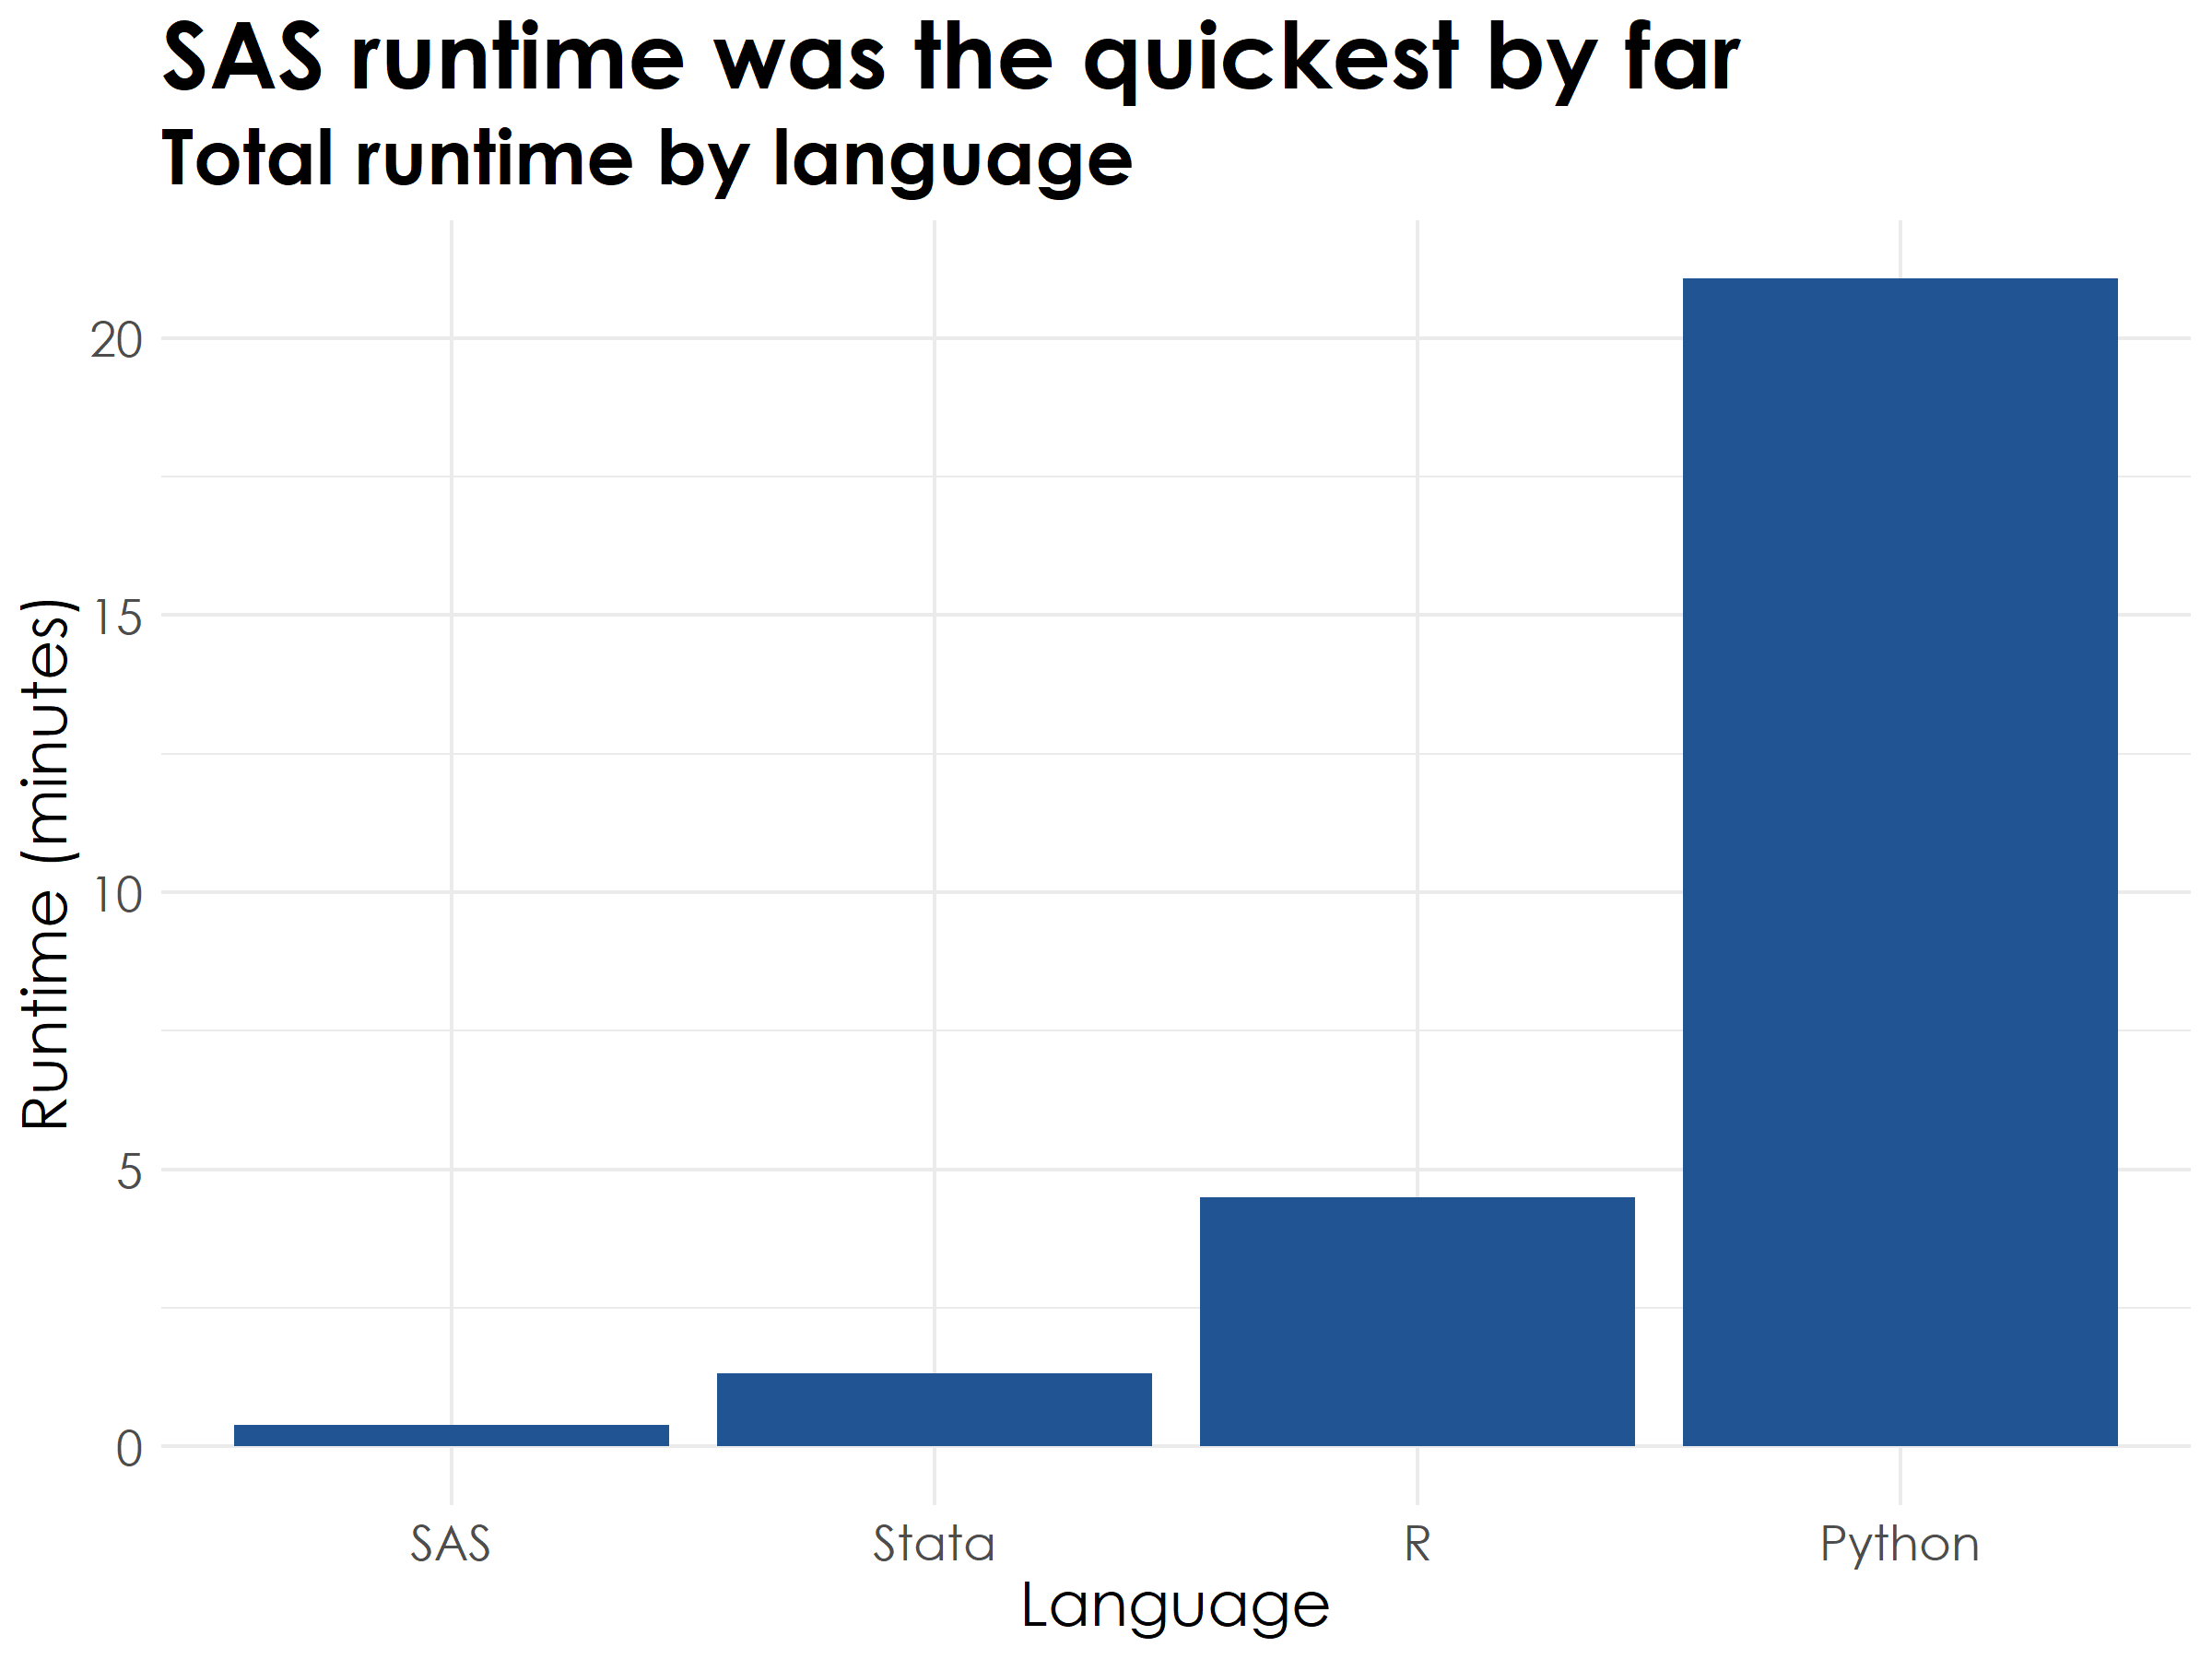

Slide 11
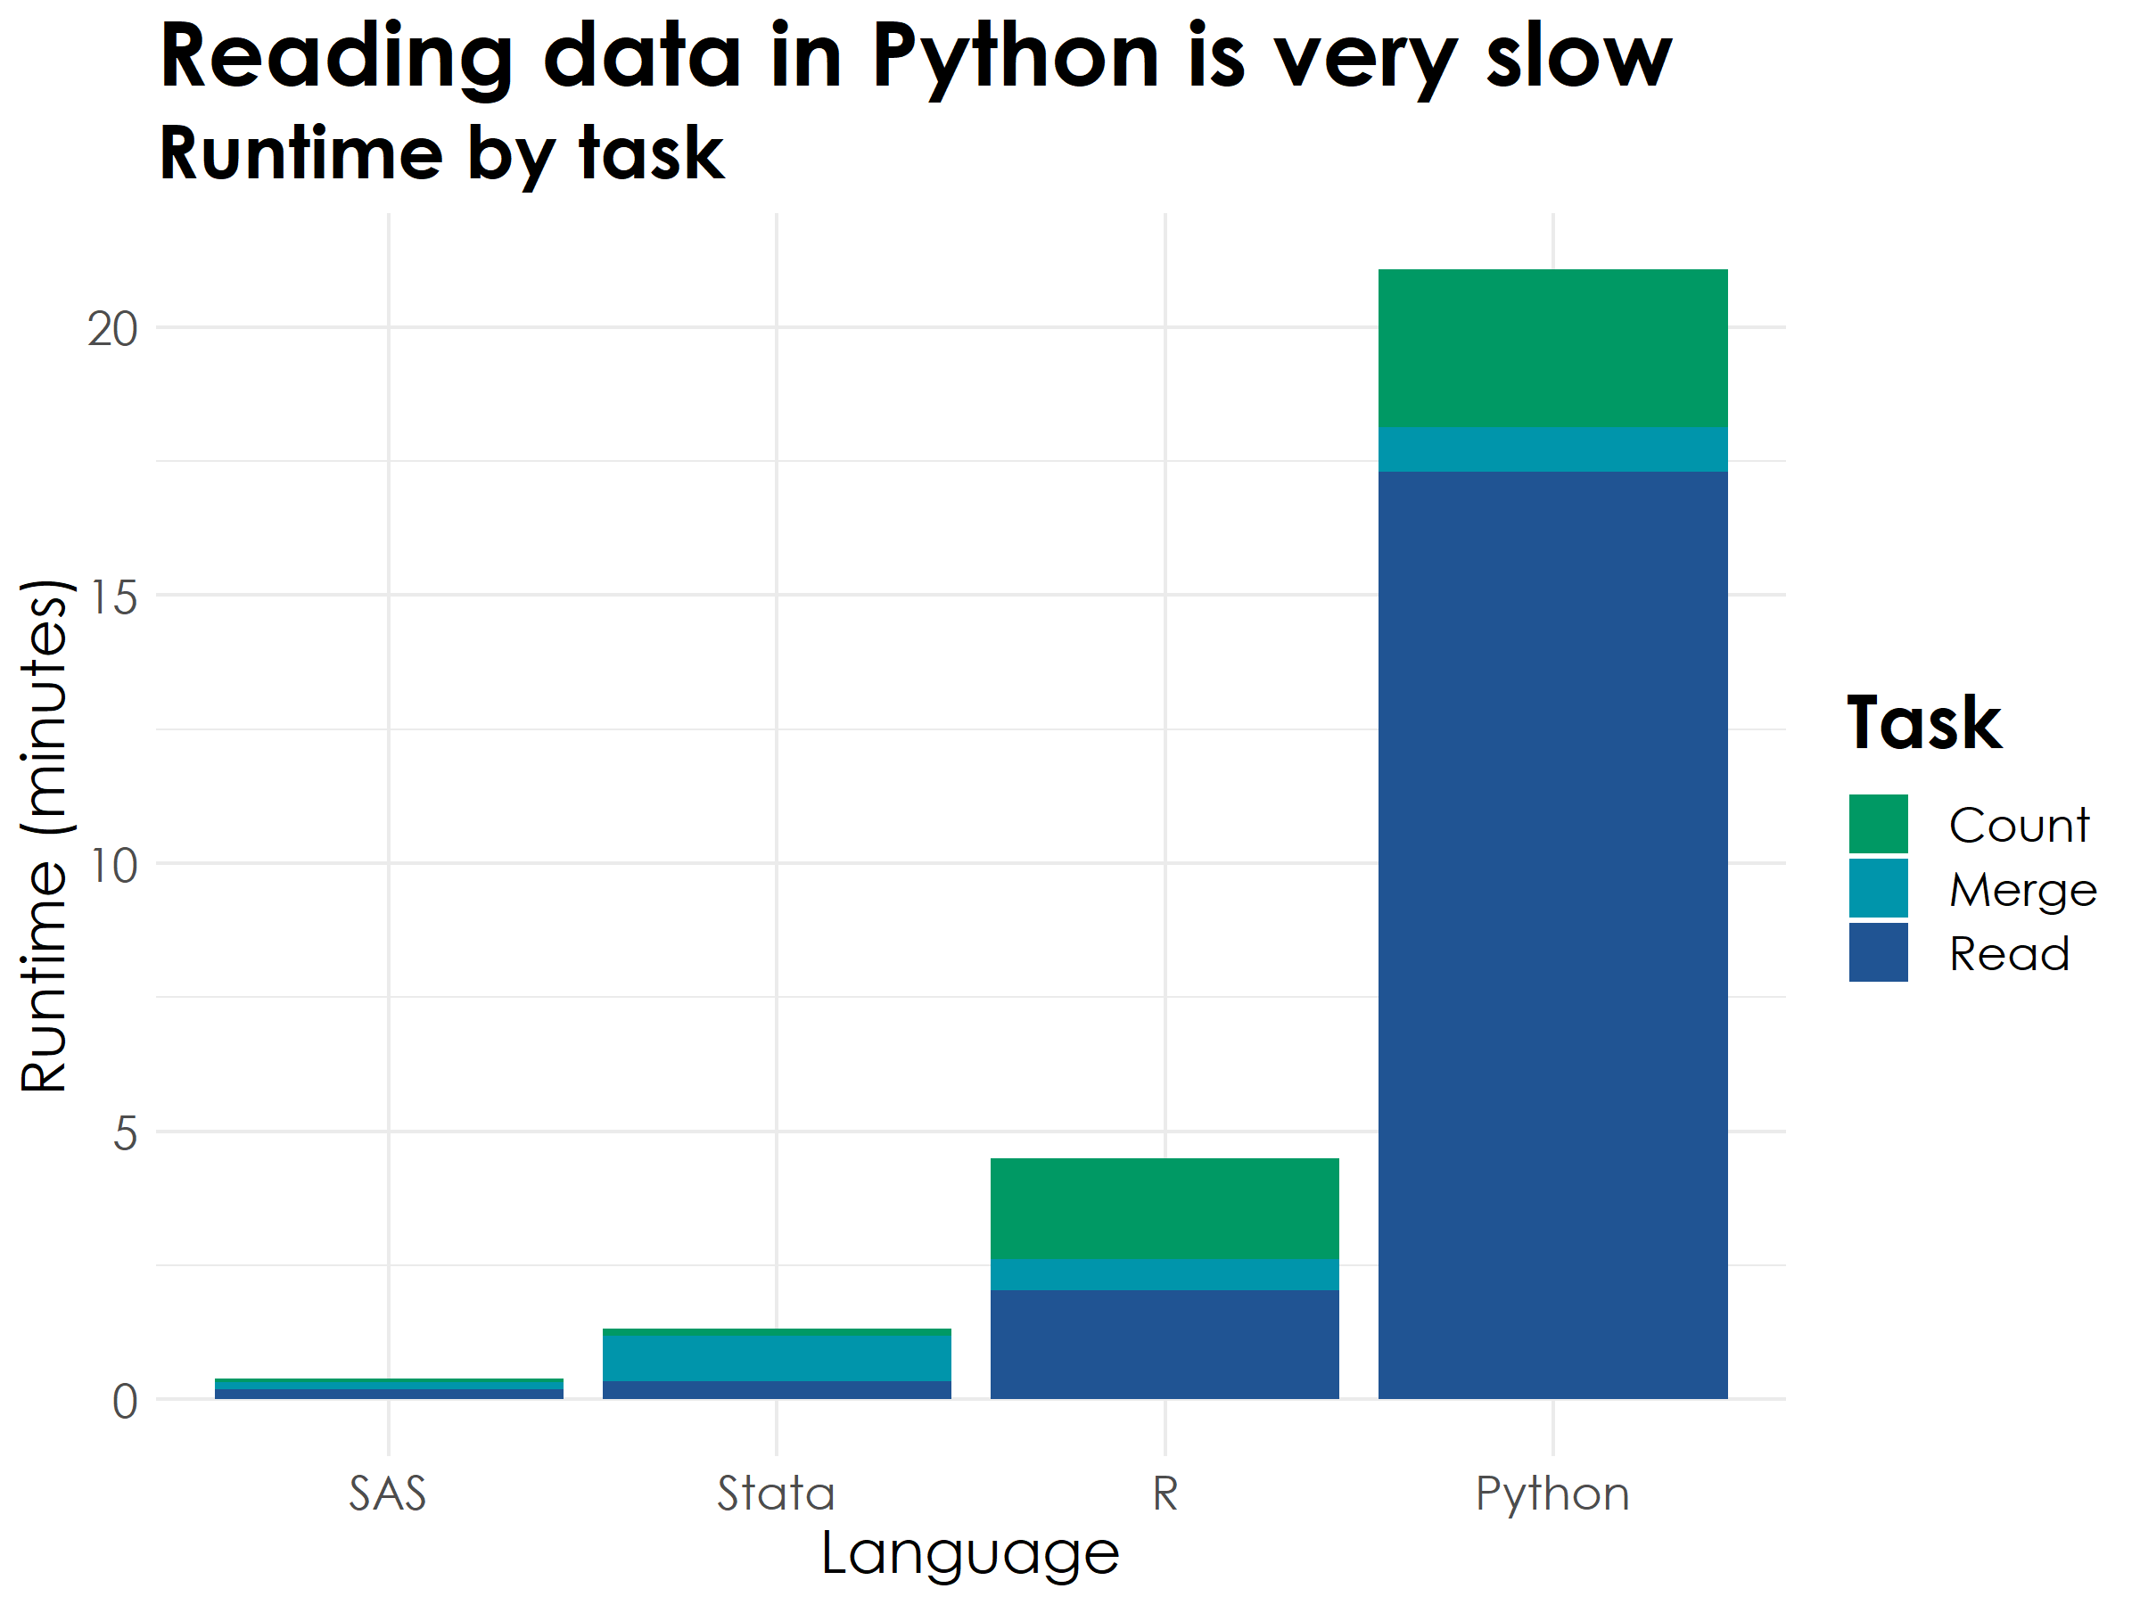

Slide 12
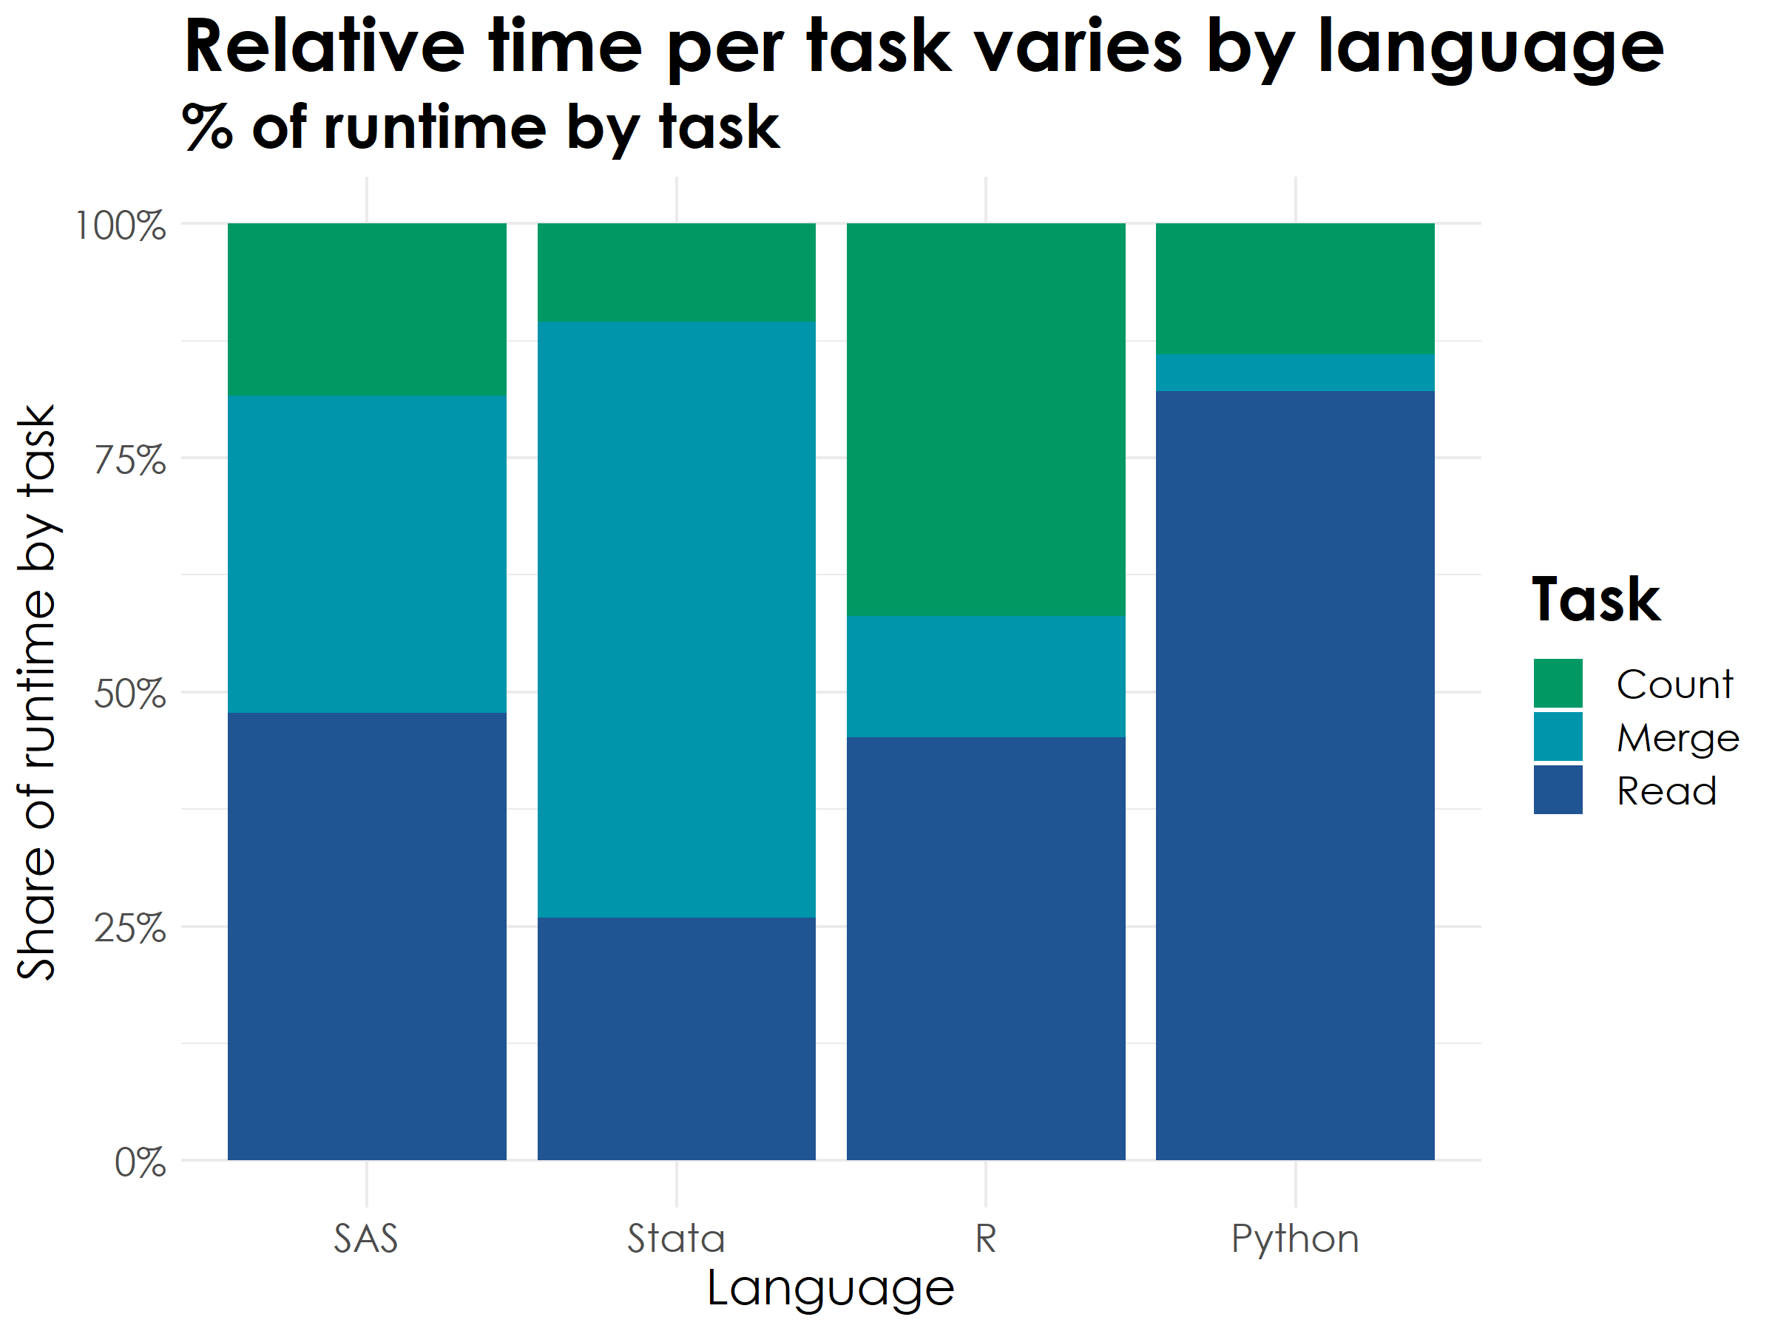
Note: Task divisions are not exactly comparable since Stata merges involve reading from disk.

Slide 13
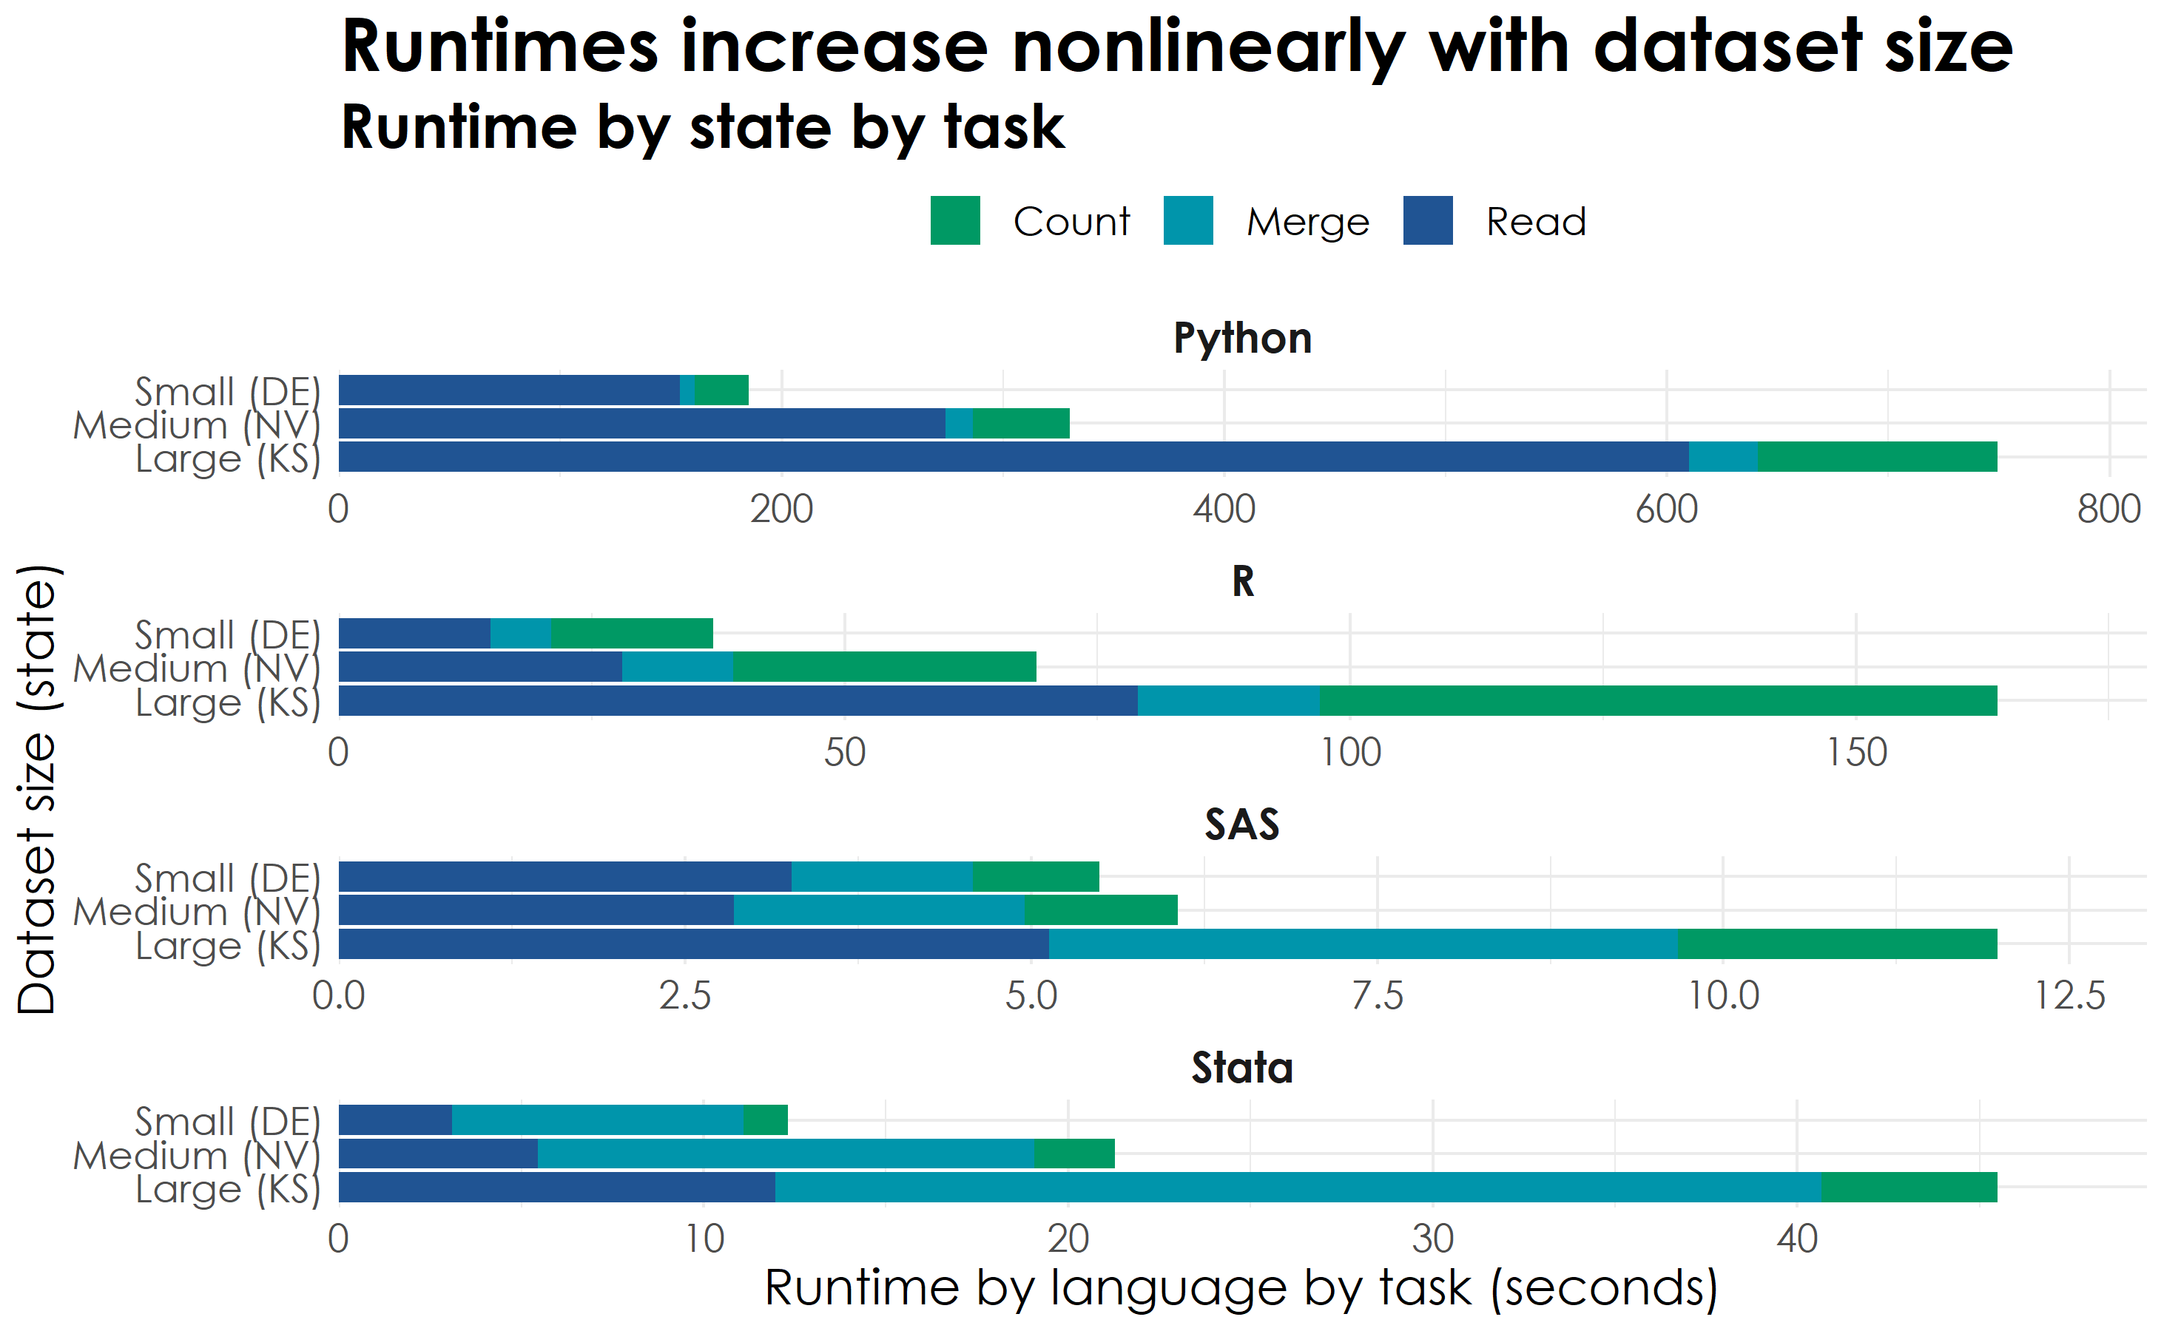
Note: X-axis scales are different due to wide variation in runtime by language

Slide 14
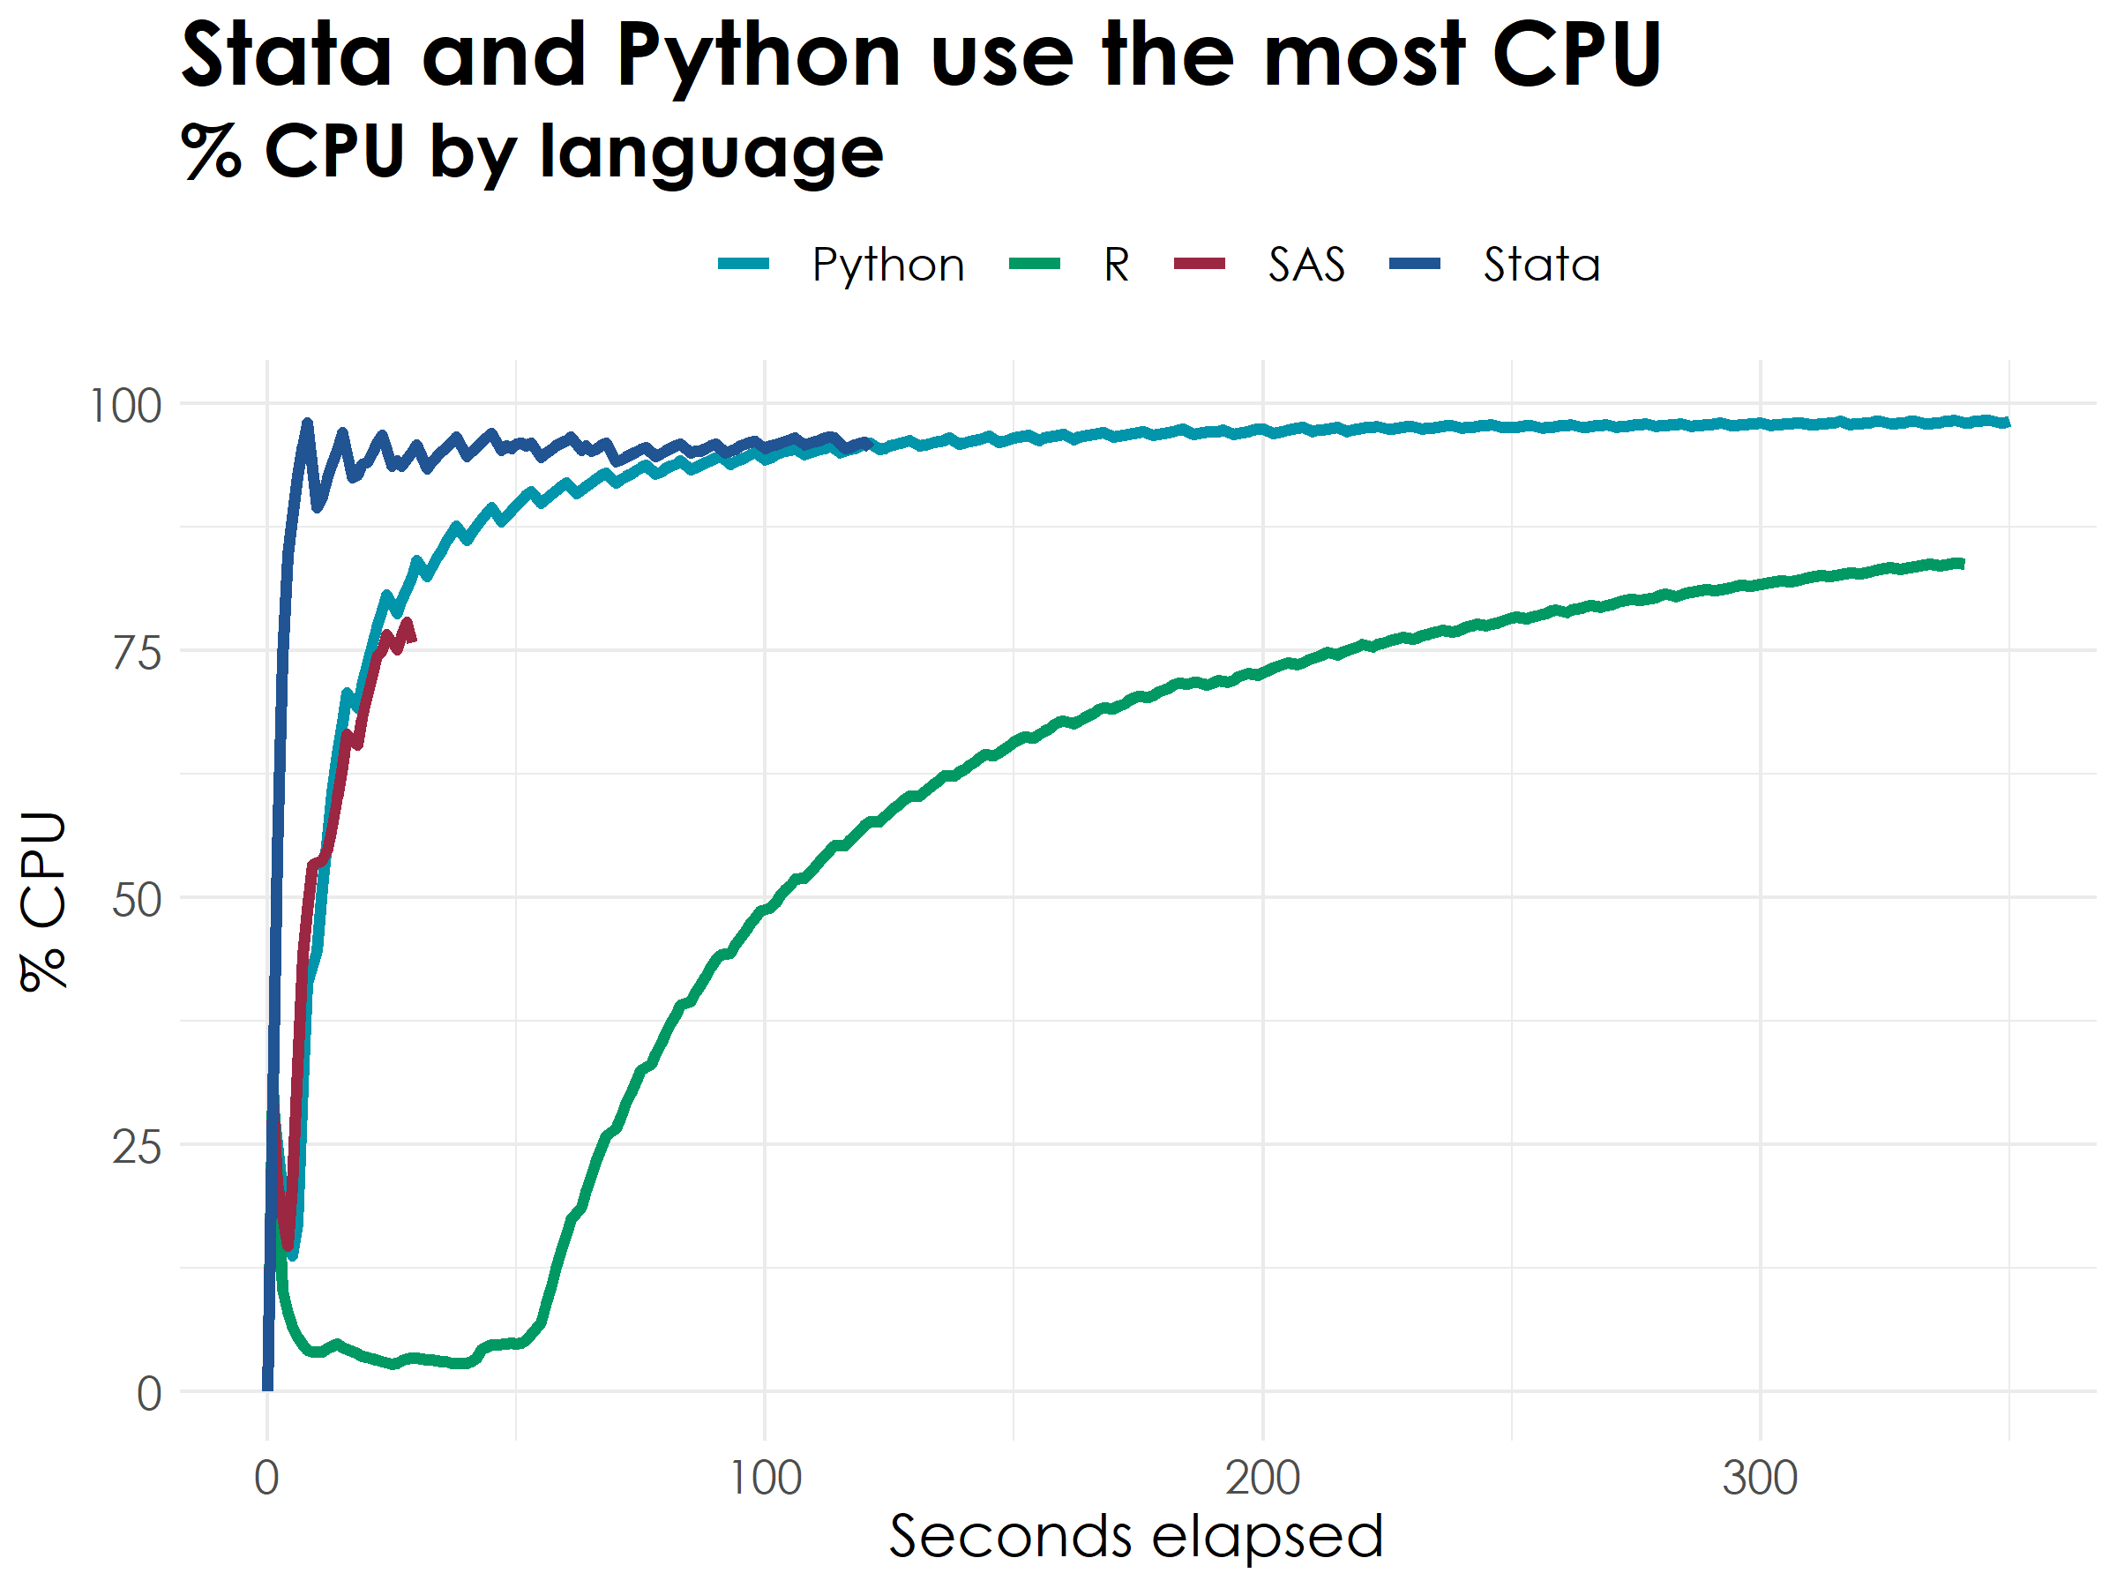
Note: X-axis is truncated at 350 seconds but Python memory usage remains steady for the remainder of runtime.

Slide 15
Initial conclusions
SAS is the fastest and uses the least CPU
Python is about 40 times slower than SAS and has one of the highest CPU usage levels
Converting files out of native SAS format likely slows down R and Python substantially
Stata is CPU-intensive and spends most of its time on performing merges
R spends relatively less time on merges and requires less CPU, but this implementation of the analytical steps is slow

Slide 16
Future work
Incorporate measures of peak memory usage
Experiment with measuring performance after conversion from SAS format
Explore ways to optimize code in each of these languages
Explore parallelization to leverage HPC resources
Benchmark performance with more complex analytical tasks
Consider qualitative measures such as the length and complexity of scripts

Slide 17
Thank you for listening!
Questions?
Cecile Murray
cecile.m.murray@census.gov
Check out our code: https://github.com/census-bds/statistical-language-profiling

